Slide 1


Website Traffic Analysis.
When analyzing website traffic, it's crucial to go beyond traditional methods. Incorporating machine learning models can provide insights into future traffic trends and user behavior patterns

Slide 2

Topics Covered in this Presentation
Jupyter Notebook Interface.
Enhanced analysis.
Data Extraction with Jupyter Notebook.
Visualization with Python Libraries.
Using Machine Learning Algorithms.
Conclusion.

Slide 3


Enhancing Analysis with Data Extraction and Cognos Analytics
Data Extraction
Cognos Analytics
Efficiently extract relevant data for analysis.
Utilize Cognos Analytics for comprehensive visualization and reporting.For the easy understanding for the visualizer.
Extracting the data and used for more enhanced problems.

Slide 4

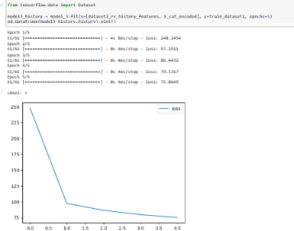
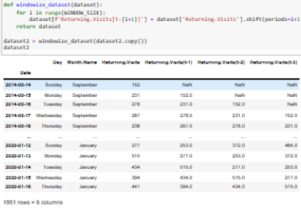
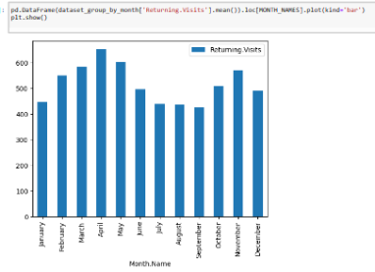
Jupyter Notebook Interface.
Machine Learning Algorithms in Jupyter Notebook.
Executing Code in Jupyter Notebook.
Visualizing Data in Jupyter Notebook.
Showcasing the implementation of KNN, CNN, and Gradient Descent algorithms in Jupyter Notebook.
Witness the step-by-step execution of code snippets within the Jupyter Notebook environment.
Demonstrating the power of data visualization using Jupyter Notebook's interactive capabilities.

Slide 5
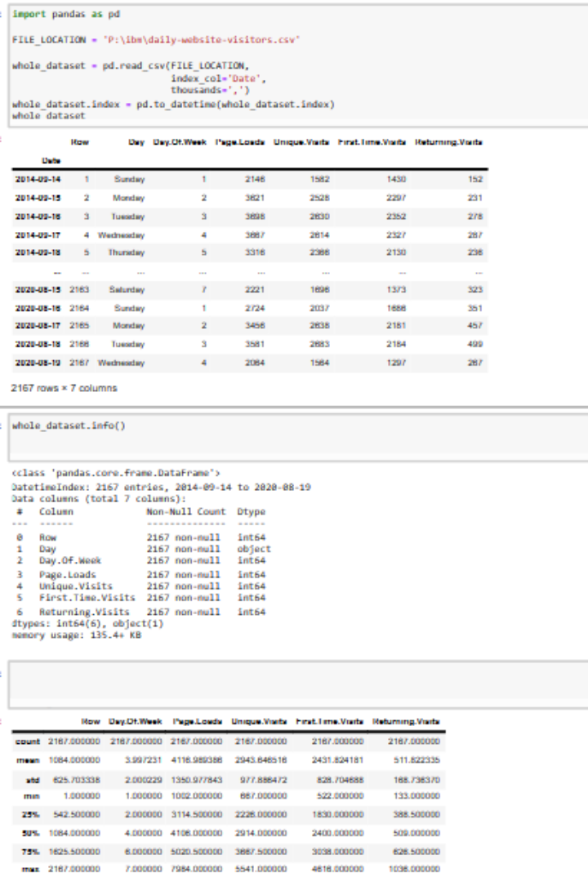
Data Extraction with Jupyter Notebook.
Jupyter Notebook is widely used to extract data due to its high flexibility and user-friendly interface. For this project, we utilized Jupyter notebook to extract data from CSV files. Jupyter Notebook is an open-source web application that allows you to create and share documents that contain live code, equations, visualizations, and narrative text. It is a popular tool among data scientists, researchers, and educators for interactive computing and data analysis.

Slide 6
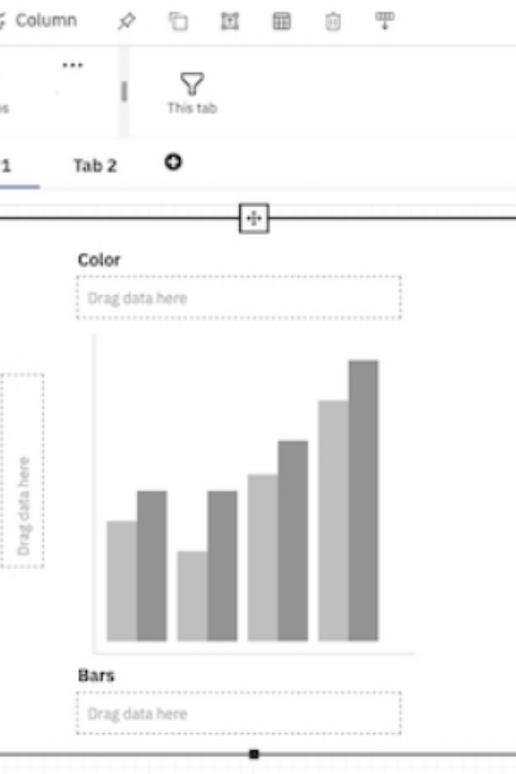
Visualization with NumPy, Pandas and Matplotlib.
In this section, we will demonstrate how NumPy and Pandas Data Frame were used for effective data visualization. NumPy, Pandas, and Matplotlib are three popular Python libraries that are often used together to handle and visualize data effectively.

Slide 7

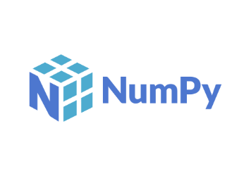

Numpy, Pandas, and Matplotlib.
Numpy
Pandas
Matplotlib
Numpy used for the numerical access to the content of the given data.It provides support for working with large, multi-dimensional arrays and matrices of data, along with a collection of mathematical functions to operate on these arrays.
Efficiently analyze and manipulate data using the Pandas library.It provides easy-to-use data structures and functions for working with structured data, such as spreadsheets, databases, and CSV files.
Matplotlib is a popular Python library for creating static, animated, and interactive visualizations in 2D and 3D. It provides charts, plots, graphs, and figures, making it a fundamental tool for data visualization and scientific plotting

Slide 8
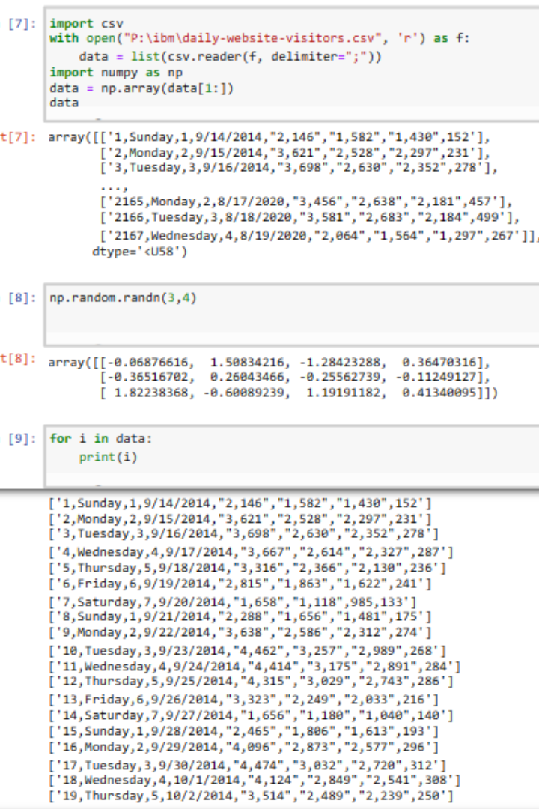
NumPy
Multidimensional Arrays: NumPy's core data structure is the ndarray (n-dimensional array).
Data Types: NumPy provides a wide range of data types, including integers, floating-point numbers, complex numbers, and more. You can specify the data type when creating an array, which is particularly useful for numerical precision.
Array Operations: NumPy offers a vast array of mathematical, logical, and statistical functions that operate on arrays. This includes basic operations like addition, subtraction, multiplication, and more advanced functions like matrix multiplication, statistical analysis, and FFT (Fast Fourier Transform).

Slide 9
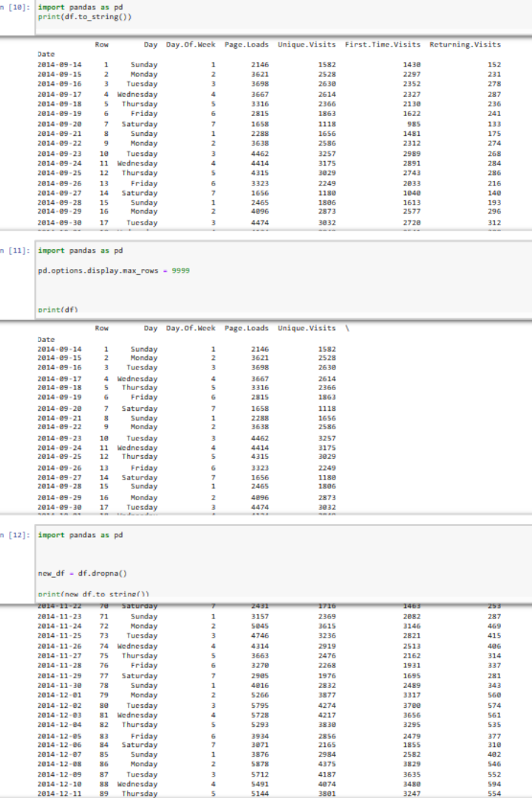
Pandas
DataFrame and Series: Pandas introduces two primary data structures:DataFrame: A two-dimensional, tabular data structure that resembles a spreadsheet. It consists of rows and columns. Series: A one-dimensional array-like object that represents a single column or row of data.
Data Cleaning: Pandas offers tools for data cleaning and preprocessing, including handling missing data, filtering, sorting, and merging datasets.
Data Analysis: It provides a wide range of functions for data analysis, including descriptive statistics, aggregation, and groupby operations. You can easily calculate statistics and perform calculations on your data.

Slide 10
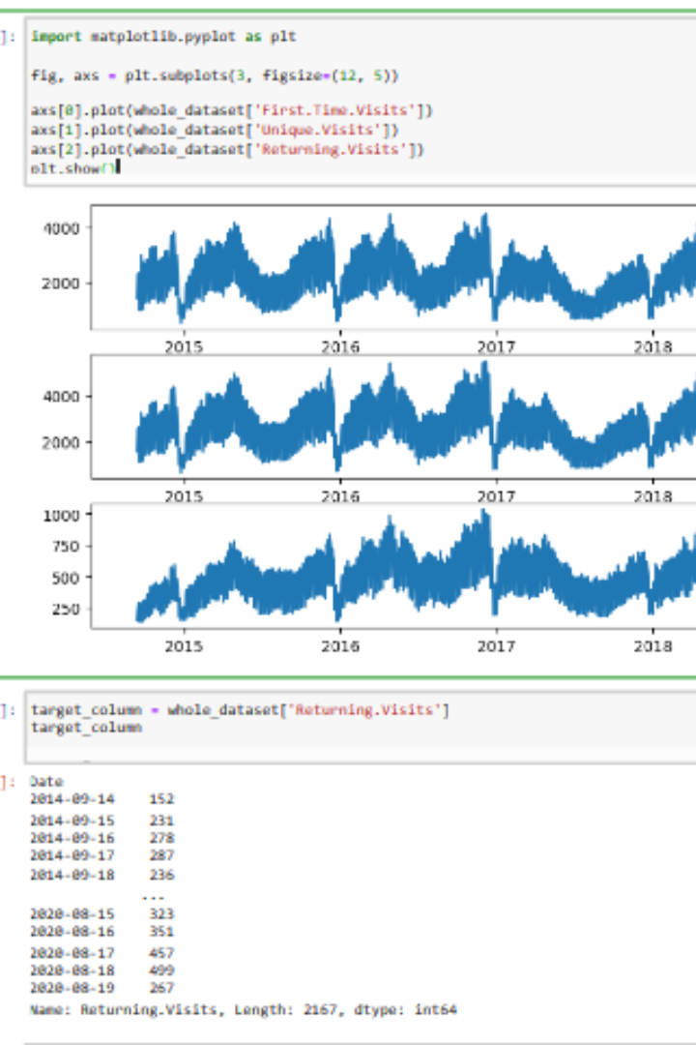
Matplotlib
Versatile Plotting: Matplotlib allows you to create a wide variety of plots, including line plots, scatter plots, bar plots, histograms, pie charts, error bars, heatmaps, and more.
Object-Oriented Interface: Matplotlib provides both a state-based interface (similar to MATLAB) and an object-oriented interface. The object-oriented interface is more flexible and powerful, making it suitable for complex and customized visualizations.
Publication-Quality Output: Matplotlib produces high-quality, publication-ready figures and supports various file formats for saving your plots, including PNG, PDF, SVG, and more.

Slide 11
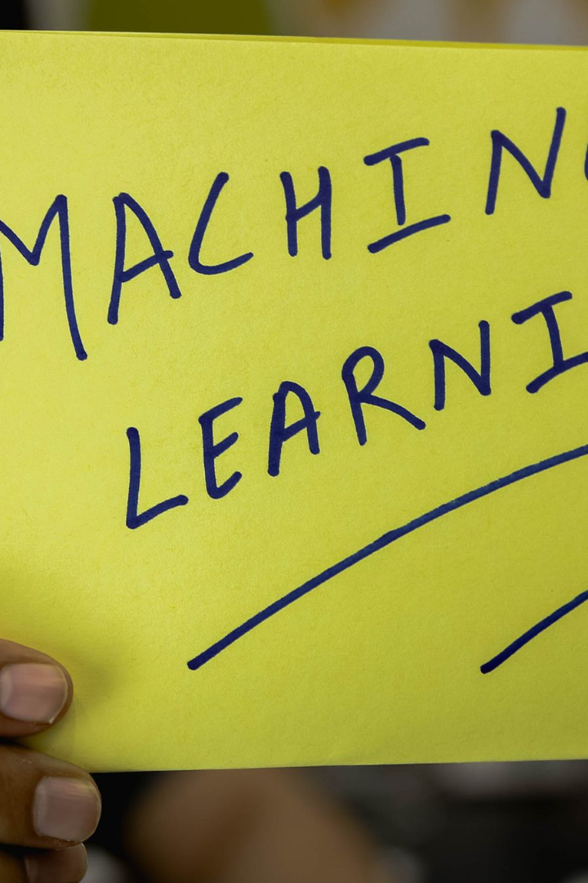
Machine Learning Algorithms for Advanced Analysis
1
K-Nearest Neighbors (KNN)
2
Convolutional Neural Networks (CNN)
A versatile algorithm for classification and regression tasks
Ideal for image classification and recognition
3
Gradient Descent
An optimization algorithm widely used in machine learning

Slide 12
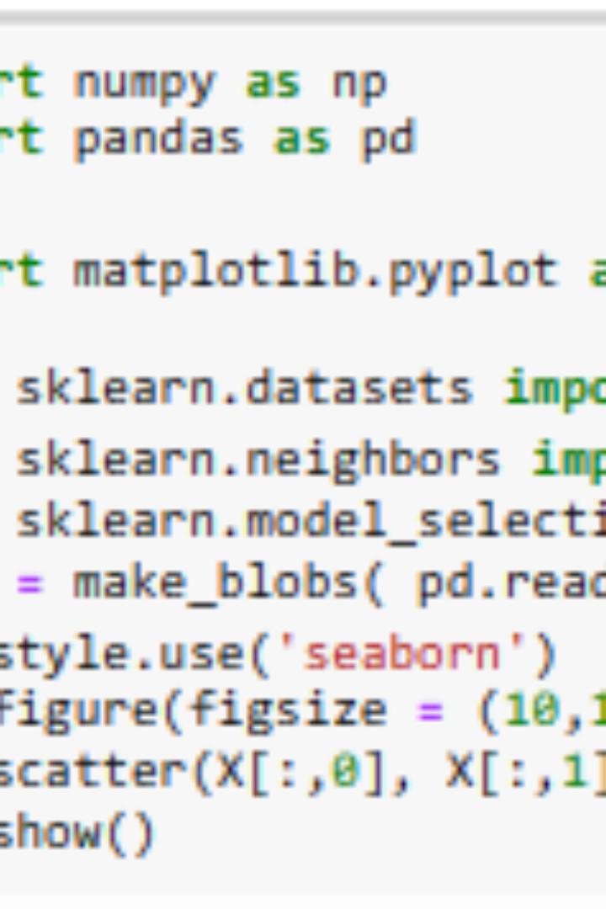
K-Nearest Neighbors (KNN) Algorithm
The K-Nearest Neighbors (KNN) algorithm is a supervised machine learning algorithm used for classification and regression tasks. It is a simple yet powerful algorithm that is based on the principle of similarity, assuming that similar data points tend to have similar outcomes.

Slide 13
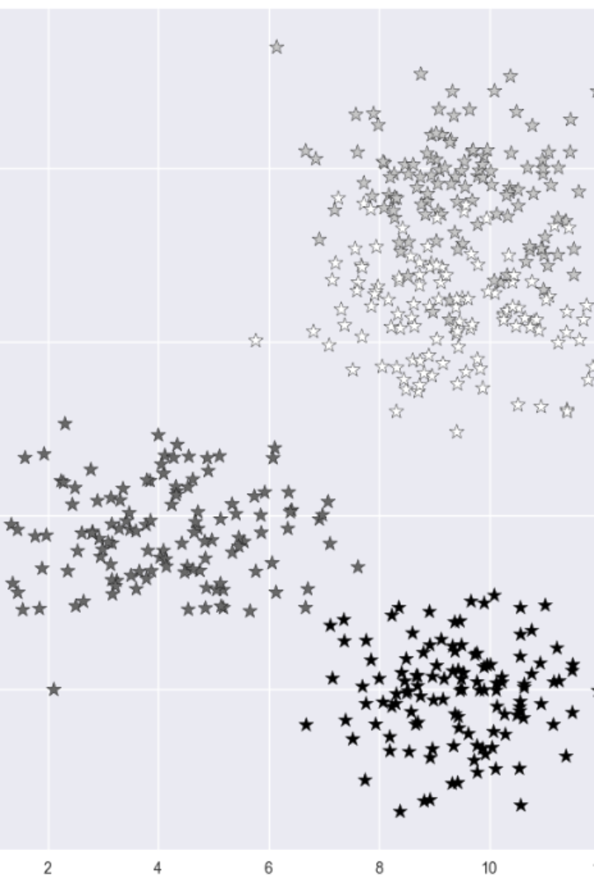
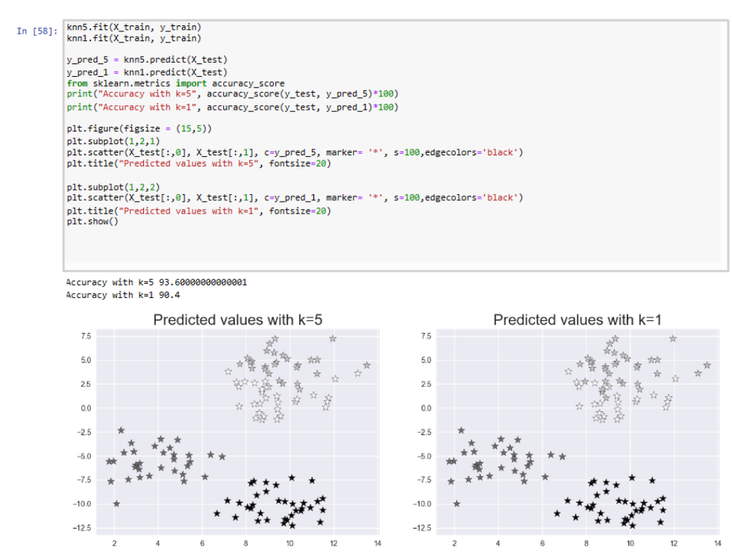
KNN visualization.

Slide 14
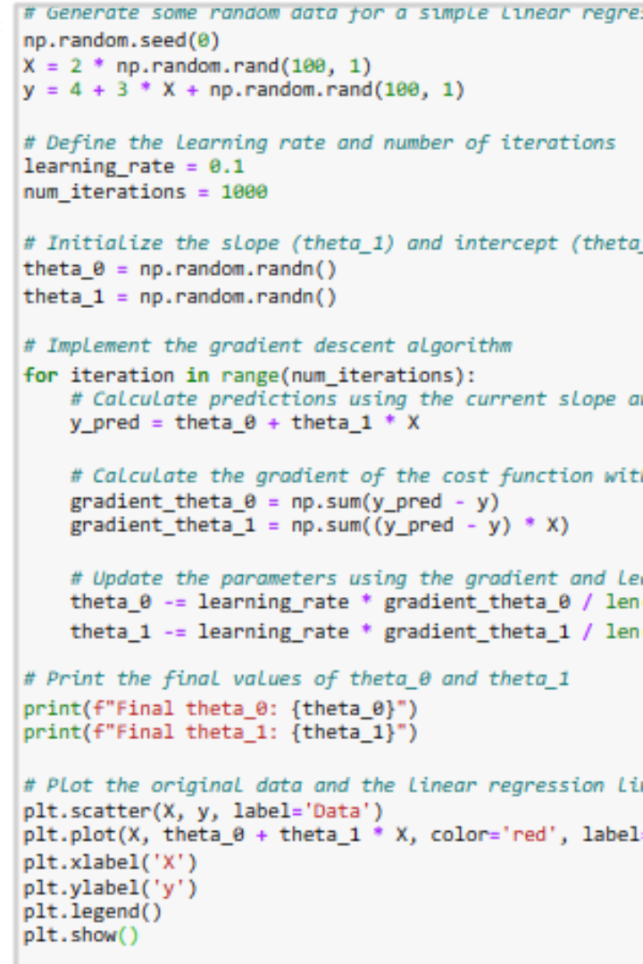
Convolutional Neural Networks (CNN)
1.Convolutional Operation: CNNs derive their name from the key operation they employ: convolution. The convolution operation helps identify patterns, edges, and textures within the data.
2.Feature Hierarchy: CNNs are designed to automatically learn hierarchical representations of features. Lower layers typically capture simple features like edges and colors, while higher layers progressively recognize more complex structures and object parts.
3.Activation Functions: Activation functions like ReLU (Rectified Linear Unit) introduce non-linearity into the network. This non-linearity is crucial for the network to model complex relationships in the data.

Slide 15
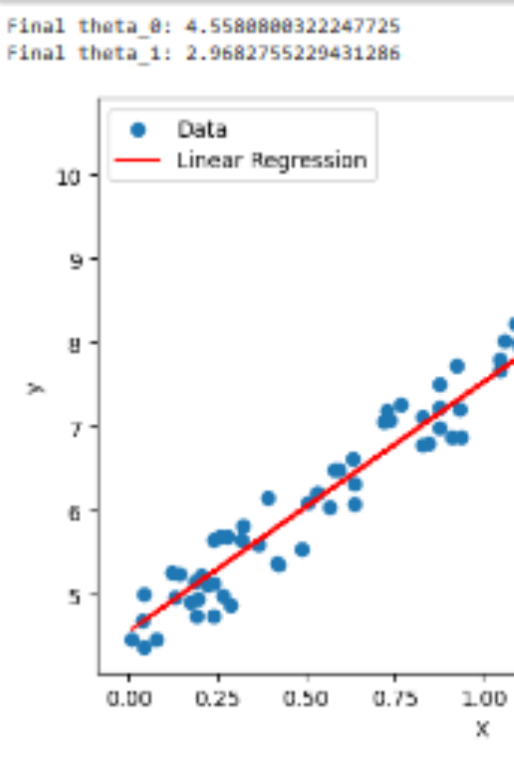
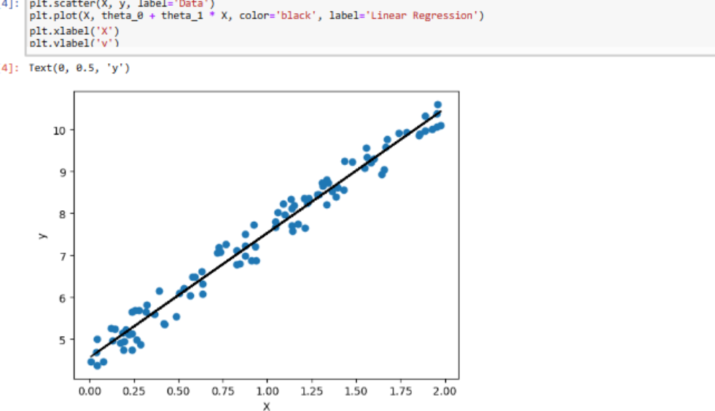
CNN visualization.

Slide 16
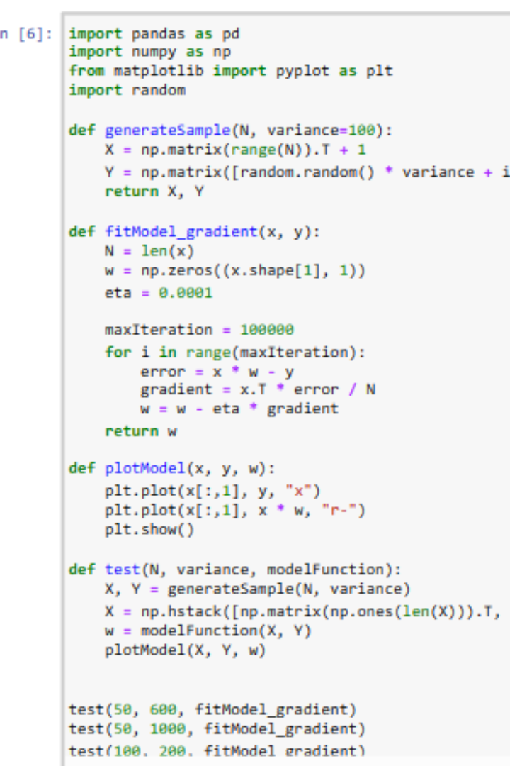
GRADIENT DESCENT.
Initialization: The process starts with an initial guess for the model parameters. These parameters determine the model's output, and the goal is to adjust them to minimize the cost function.
Computing the Gradient: The gradient of the cost function with respect to the model parameters is computed. It provides information about how the cost function changes as each parameter is modified.
Iterative Process: Steps 2 and 3 are repeated iteratively. The goal is to keep adjusting the parameters in the direction that reduces the cost function until a minimum (or a local minimum) is reached.

Slide 17
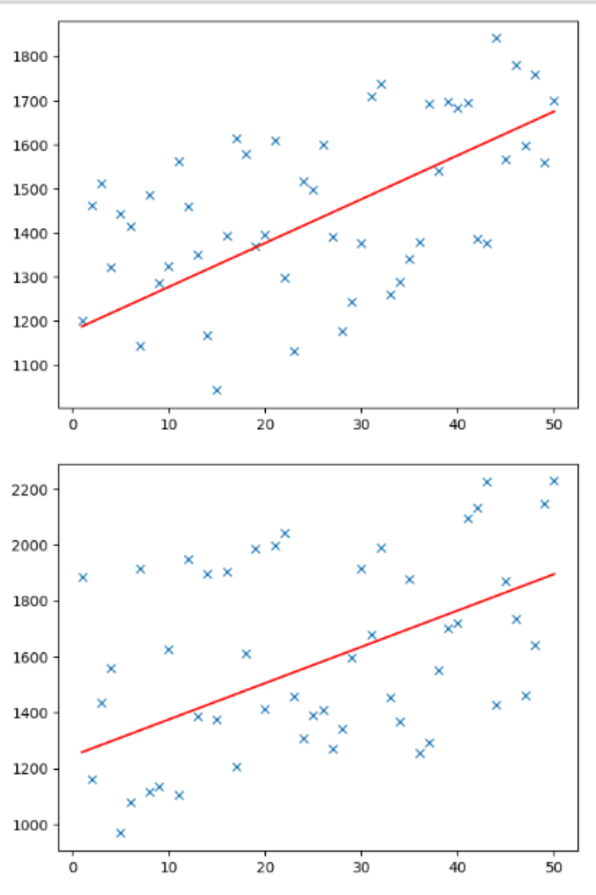
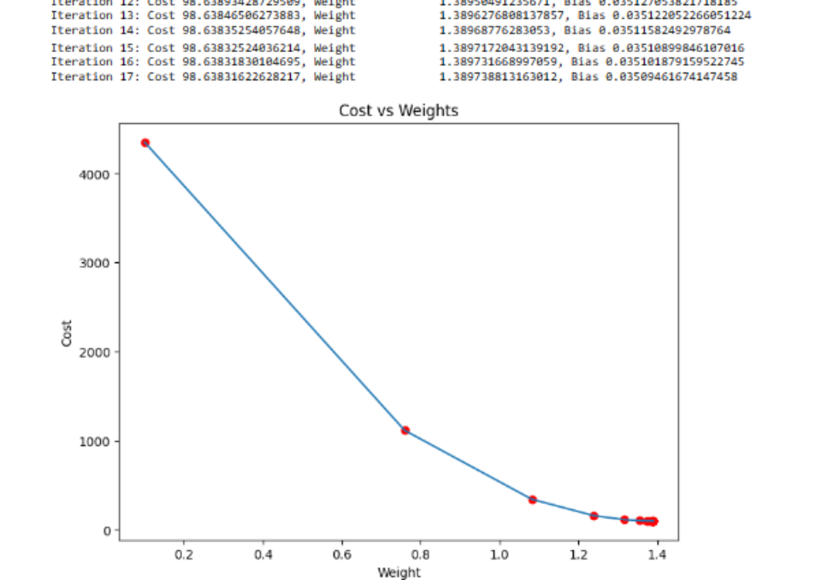
GRADIENT DESCENT visualization.

Slide 18

Conclusion.
By leveraging machine learning models, data extraction techniques, and powerful analytic tools, website traffic analysis can reach new heights. The combination of Python, Pandas, Matplotlib, and various machine learning algorithms opens up endless possibilities for understanding and predicting user behavior. Stay ahead of the competition and make informed decisions for your online presence.

